Slide 1

Avoid Relapse Stay Sober: Android Application
Guided by : Dr.P.G. Sunitha Hiremath
Team 13
Roll no | Name | Usn
502 | Shivani C Guranalli | 01FE19BCS265
517 | Madhura Nagaraj Nayak | 01FE19BCS285
520 | Soumya Jakkali | 01FE19BCS288
522 | Supriya Khemalapure | 01FE19BCS290

Slide 2
Introduction
Excessive and long-term consumption leads to major health problems. Even low consumption over longer period has drastic effects.
Alcohol kills 2.6 lakh Indians every year according to WHO report in the year 2018.
There are many rehabilitation centres for treatments of alcoholism across India.
Many Rural people are unaware about rehabilitation centres and camps.
Most of the people struggle to stay sober life after the treatment.
To support and motivate them to stay sober many android applications have been developed.
People in recovery can seek support from apps without having to call a hotline, join a group or seek out a therapist in person.
Apps are cost effective. Many addiction apps for smartphones are free or inexpensive.

Slide 3
Motivation
Over 70% of people trying to quit alcohol get relapsed.
To assist them in finding rehabilitation centres and camps as they will not be aware of such camps.
Most of them do not think that rehabilitation camps will help them and some are not aware of rehabilitation camps that are being held at their area.
Developing an application such that it is simple, accessible and easy to use for rural people and it should be available in regional language.
Most of the apps are not simple to use for rural people to understand and use.

Slide 4
Existing systems
1. Clean time counter : Clean time counter is a Russian app released on 23 January 2013, developed by topotApps. It is available for free and downloaded by more than 500k people. This app takes the date, time of quitting alcohol and options to select addiction type. User can add name, gender, password and it is optional. It counts the sobriety time in days, hours, minutes and in seconds. Useful for recovering alcohol addicts. Drawbacks are it has only one feature and no options to get connected with the sober community. 2. EasyQuit Drinking : 1) It is a German app released on 17 December 2016, developed by Mario Herzberg. It is available for free and downloaded by more than 500k people. 2) This app does not take any user information except date and time of quitting alcohol. Money spent weekly, drinks per week and currency symbol need to be set so that the app calculates how much money saved from the day of quitting. Mind games will help to distract his mind from triggers. Total health section contains 18 health conditions with the time to reach that health condition, it will decrease based on sobriety days count and show the percentage of improvement. 3) User can add their craving for 10 marks and triggers. Its history will be available to analyze. Some other features are helpful tips to avoid triggers, quit slowly mode, dairy to add our feelings, motivation section to add quotes or any motivational thoughts. 4) Lifetime regained will be counted, based on achievement badges are given, we can add relapse count and start again by setting date or ignore relapse or shift quitting date to week or month. 5)It helps to motivate the people. Drawbacks are all these features helpful for urban literate people but not for illiterates, not simple to use, there is no definite output for some features so that users should analyze on their own.

Slide 5
3. Iron Will :
Iron will was released on 11 February 2019, developed by Emerald Isle studio. It is available for free and downloaded by more than 500k people.
It counts soberity in days, months and in years. Rank is given based on days of sobriety.
Reset button is to set time again during this user can add reasons or short notes for relapse and this history is saved to analyze. Person can see his/her sober days on the home screen by changing the settings.
Helps in tracking the progress towards soberity. Drawbacks are this app not counts in hours, minutes and in seconds and it is for the one who is willing to quit drinking.
4. I am sober :
I am sober is an American app released on 18 February 2014. It is available for free and memory space required is 52.86 MB. More than 10L people are using this app. It takes a date from which a person is sober and it will set the track on it.
It takes aim from the user and motivates him or her to quit alcohol. It makes him take pledge every day, sends notification everyday to take pledge and it gives motivational thoughts.
Users can post photos and share their experience with other users. There is a provision for a personal diary where the user can write his personal things so that they can recap their past.
Savings of money, time, calories can be calculated. It maintains the statistics of the current pledge streak, longest pledge streak, total pledge, total reviews. This app has some drawbacks, since all the features are through texts, illiterates cannot use this. There is a chance of posting irrelevant posts.

Slide 6
5. AA Speaker : AA speaker Free is a Britain app released on 15 September 2014, developed by Marnistek, made in the United Kingdom. It is available for free and memory space required is 16.03 MB. This application has been downloaded by more than 100k people. Users of this app are UK people and those who are fluent in english. Features of this app are it has more than 500 speeches of recovery people, Joe and Charlie's big book study part by part 34 audios, audios of big book study alcoholic anonymous written by Bill Wilson, 12 steps and 12 traditions of alcoholic anonymous and audios of workshops that are held at different places. Drawbacks of this app are that people who do not know English are unable to use this app and there is no interaction between people. 6. Sobriety clock : Sobriety clock is an American app released on 22 september 2014, developed by Michael Tiffany. It is available for free and memory space required is 9.92 MB. This application has been downloaded by more than 100k people. Users of this app are people who read and understand English. Features of this app are it keeps track of how long a user has been sober. The 12 steps of recovery, the user can browse quotes, read quotes and add quotes and can set sponsor contact so that he or she can make a phone call in a single touch. Drawbacks of this app are rural people may find it difficult to use this app, illiterates cannot understand 12 steps of recovery since they are in english, if the user relapses then there is no option to reset or change the sober day count.

Slide 7
7. No relapse : No relapse is an Indian app released on 25 April 2019, developed by Supervoid. It is available for free and memory space required is 16.03 MB. This application has been downloaded by over 10000 people. Users of this app are Urban educated people of India. Features of this app are it keeps track of sobriety day (that is from how many days the user has been sober) , reminds the most recent strike duration and time, it has inspirational quotes, images and posts to keep users motivated, users can save images on their phone and can share to anyone. The Drawback of this app is that the number of quotes are limited to 25 only. 8.SoberPeer : Sober Peer is a California based application, released on 2 May 2020.It is available for free and it has more than 500 users. It takes a daily survey from the user. Small groups can be created, meetings can be arranged to learn how to avoid addictions. Users can post their stories. Users can add their triggers like people or places on a map and that notifies them whenever they are in that location. Users can also choose a coach, chat with them, and join sessions. Even they can find the sober peer friend. There is a provision for journals where they can write their experiences in personalised notes. This application has some drawbacks, like the survey does not provide any results. Sessions conducted by coaches are not free. Users can not keep track of their sobriety period.

Slide 8
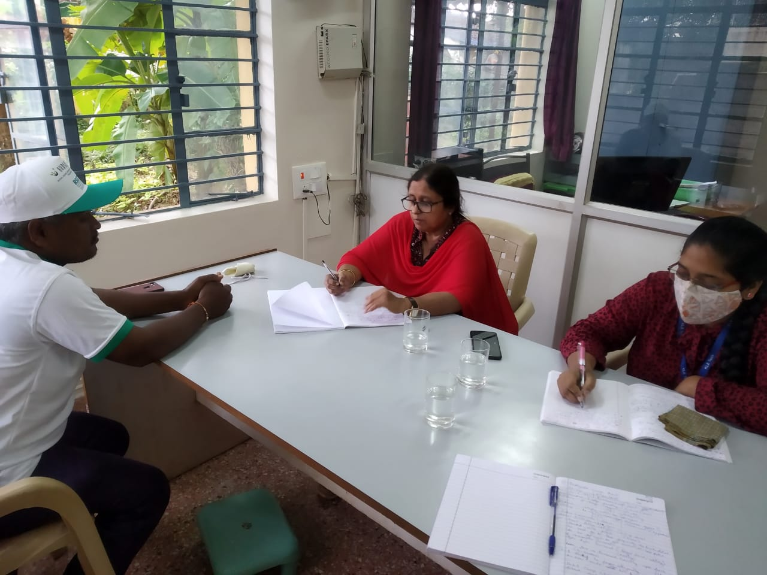
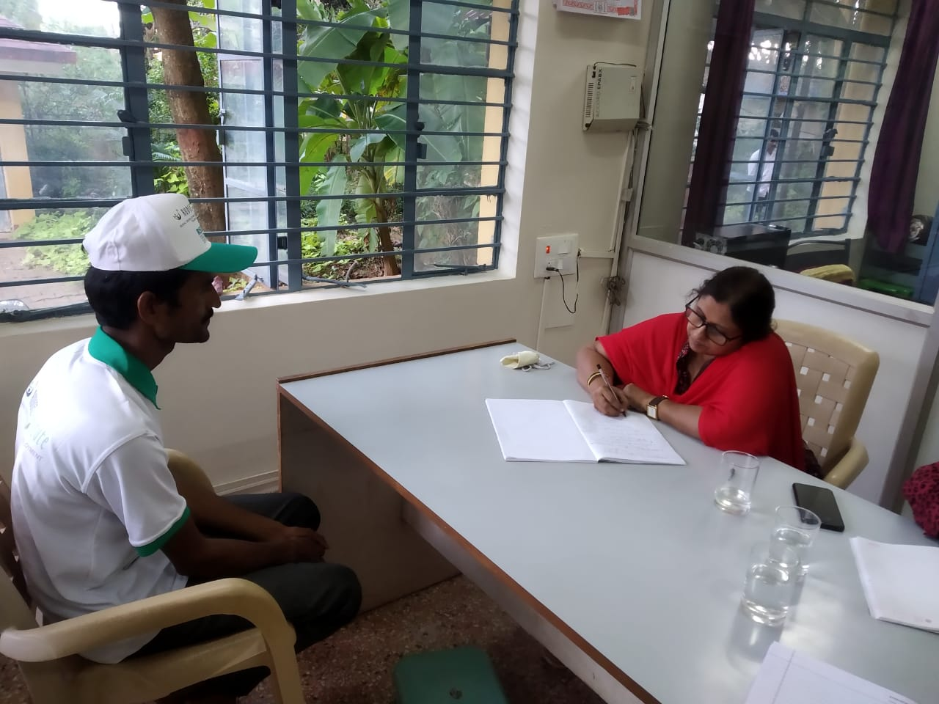
Requirement collection

Slide 9
Problem Statement
Develop an android application that helps people to find a way to avoid alcohol, calculate their risk level, find information regarding rehabilitation camps, helpline numbers, trigger avoidance techniques and track their sober days.

Slide 11
Objectives
To develop an application to
calculate the risk.
get zone wise information about rehabilitation centers.
track sobriety period and to get trigger avoidance techniques.

Slide 12
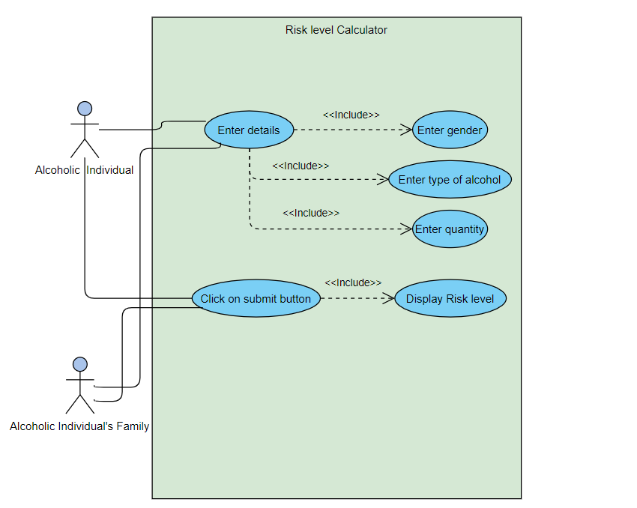
Use Case Diagram
Risk level Calculator

Slide 13
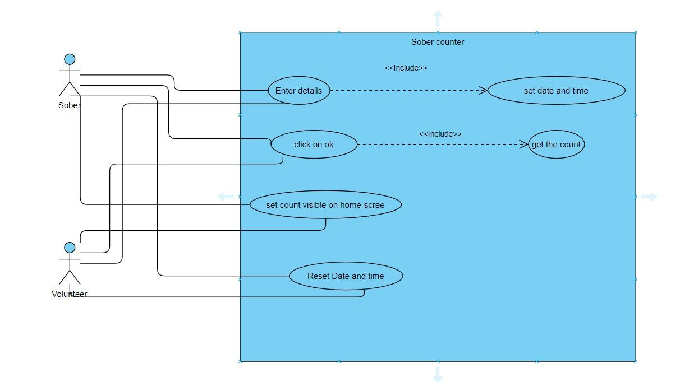
2. Sobriety counter

Slide 14
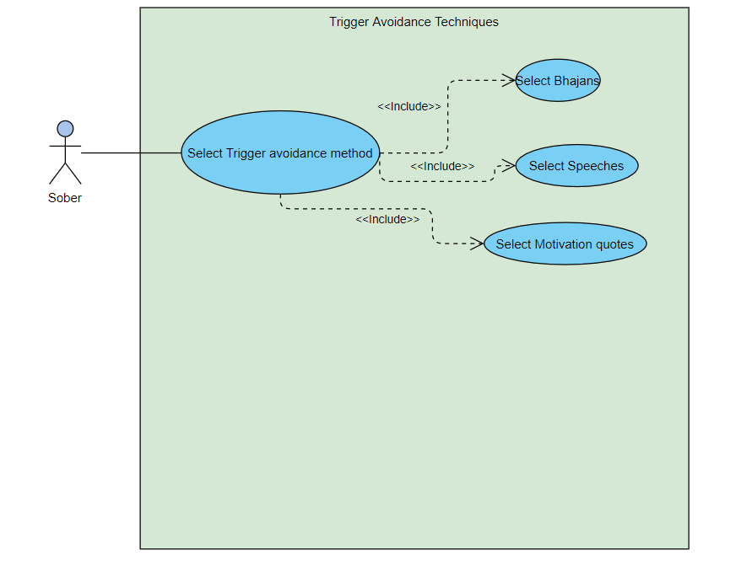
3. Triggering Avoidance Techniques

Slide 15
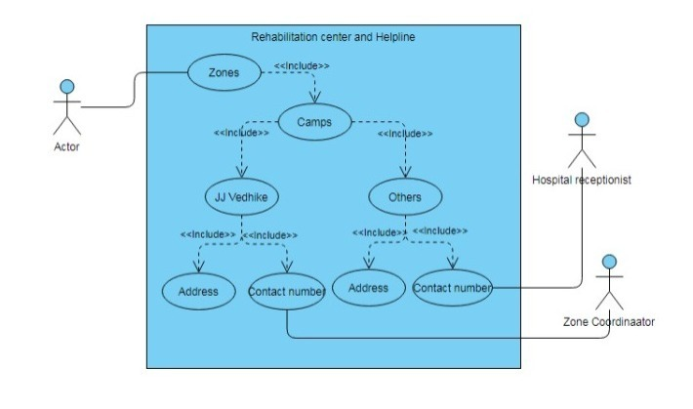
4. Rehabilitation Centers and Helpline

Slide 16
Functional Requirements
User shall be able to access information about camps of J J Vedike and nearest rehabilitation centres.
Once user clicks on rehabilitation camps button, a new page appears. Then user will select zone and district of the camp which he/she wants, then he/she will get helpline number of that particular camp.
User shall be able to get motivation to avoid triggers.
Once user clicks on helpline button for triggers he will get bhajans, motivational speeches, AA conference audios and also recorded audios to avoid some common triggers.
User shall be able to calculate the risk on alcohol consumption.
Once user clicks on risk calculation button a new page appears then user enters details such as gender, type of alcohol consumed and quantity of alcohol then click on submit button so that his/her risk level will be displayed.
User shall be able to track his sobriety period.
Once user click on sober counter button he will get page for setting date and time and clicks on ok it will be saved and count starts from that moment. User have option to reset if required.

Slide 17
Non Functional Requirements
App should compatible with different devices.

Slide 18
Proposed Android Features
Android app Name | Size | Made by | Features |  |  |  | Permission required from phone
 |  |  | Risk Calculator | Helpline | Helpline to avoid triggers | Sobriety Tracking
Sober’s Assistant | 100+ MB nearly | KLE TECH STUDENTS M13 | Calculates risk on alcohol consumption Based on gender. | Rehab details Available. SDM camp coordinators details. | Audio bhajans Aatmavalokana talks Soothing prayers Talks with professionals | Time for tracking sobriety Reset the time | Storage Phone Microphone Location

Slide 19
Language
The app provides user to change the app in 5 languages.
This helps the rural people to change the app to their known language.

Slide 20
Risk tracker
This component is helpful to calculate the ethanol content in the alcohol.
Based on the ethanol content risk level will be calculated using formula.This helps the user to keep track of their risk level and help them to quit drinking slowly.
Average ethanol content in the alcohol consumed till date is calculated this helps to know his/her history of ethanol consumption.

Slide 21
Risk Tracker Functionalities
User shall be able to enter type and quantity of alcohol consumed.
User shall be able to submit the information entered.
User shall be able to view the ethanol content in the alcohol consumed and risk level based on the ethanol content in the alcohol consumed.
User shall be able to reset if user clicks on “Reset” button information entered by the user will be erased.
User shall be able to view the average ethanol content in the alcohol consumed till that date.

Slide 22
Sobriety Tracker
It is the one of the components in the app which can help the sober people to keep track of their sobriety period.
It is required because sober person may get relapsed at any point of time but the count of sober days may motivate him to continue a sober life.
In this component user can reset the time if he/she is unable to avoid relapse and start the timer again.
Motivational quotes are displayed to motivate the user to lead a sober life whenever user resets the time.

Slide 23
Sobriety Tracker functionalities
User shall be able to set the timer.
User shall be able to view his/her sobriety period by clicking on the “Get Count” button.
User shall be able to reset the time if he relapse.
User shall be able to view the motivational quotes if he/she relapse.
If user clicks on reset without setting the time he will get message like set the timer first.

Slide 24
Helpline
Helpline component helps the people to get contact details of coordinators of SDM camp and other rehabilitation details based on district.
This helps the rural people in finding rehabilitation details very easily.
SDM camps are the one which specially helps rural people to come out of the life as alcoholic and help them in quit drinking and lead sober life.
SDM camps are separately mentioned here as this not only helps the alcoholics to lead sober life but also helps in leading the better life after becoming a sober person.

Slide 25
Helpline Functionalities
There are two sub parts in helpline in that one is SDM and other one is other Rehabilitation details.
On selecting the SDM user gets the list of districts.Selecting any district gives the contact details of the SDM rehabilitation camp coordinator of that district.
Call button is provided onclick on the button call connects to the coordinator of that district.
On selecting the other rehabilitation user gets list of districts. Selecting any one district gives list of the rehabilitation center names in that district. Selecting any one rehab center name gives the address of the rehab center and contact number of that rehab center.User can directly call using call button.

Slide 26
Component yet to be completed
Relapse Trigger Avoidance
Relapse Trigger Avoidance component is helpful for user to avoid the triggers which cause relapse.
It has two parts audios and videos.
Both audios and videos have sub-categories Aatmavalokhana talks, Motivational speeches, prayers and Bhajans.
Aatmavalokana talks is the method used in JJ Vedhike to treat the alcoholics.This talks will help in self analysing.
These audios and videos increases the spirituality, concentration and firmness in the users decision.
Audios will be playing in the background of the application also.

Slide 27
Relapse Trigger Avoidance functionalities
User shall be provided with Audios and videos option.
User shall be able to view sub-categories in audios and videos.
User shall be able to watch the videos, which is of having play and pause options.
User shall be able to choose the clips based on their interest.
User shall be able to listen to music in the background of the application also.
User shall be able to play and pause the audio clips.

Slide 28
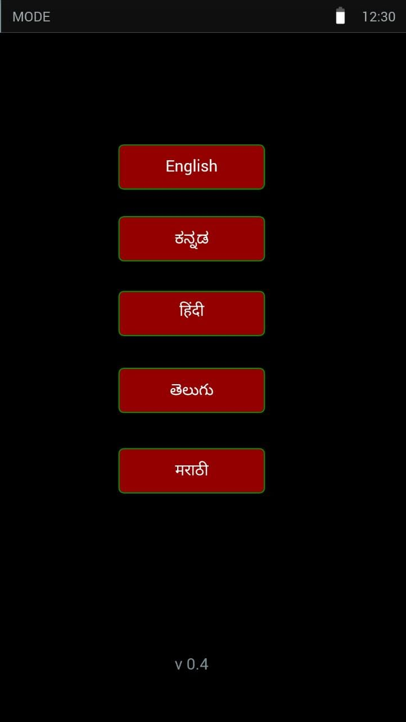
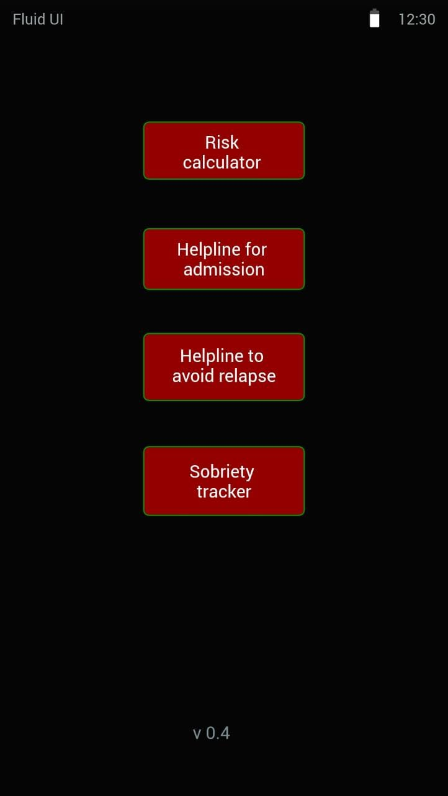
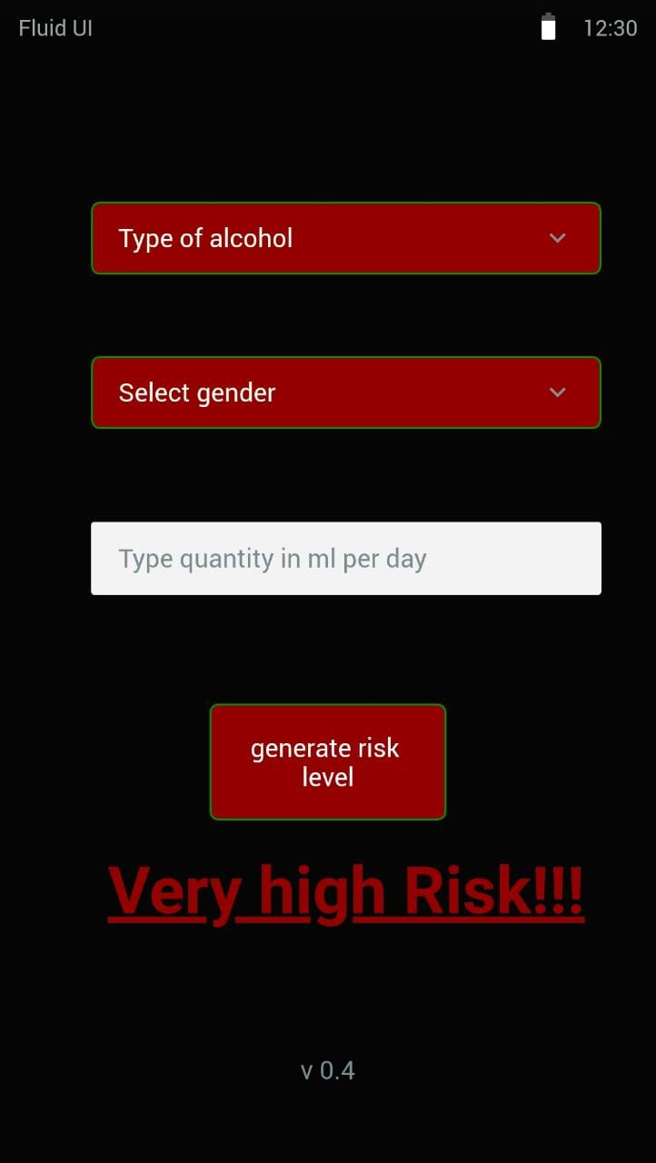
GUI Design

Slide 29
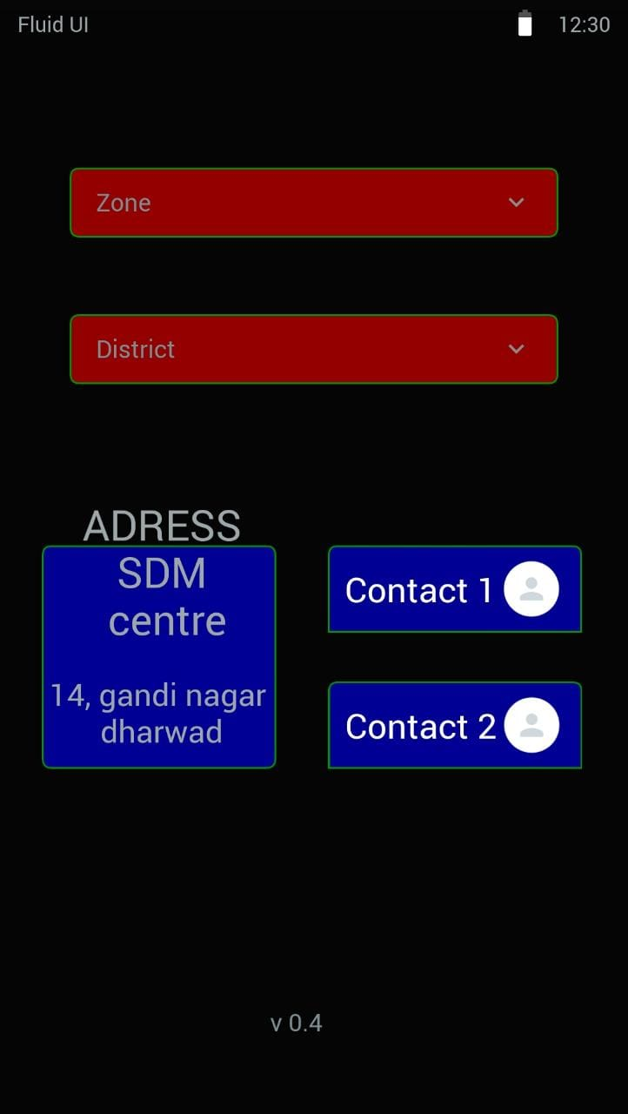
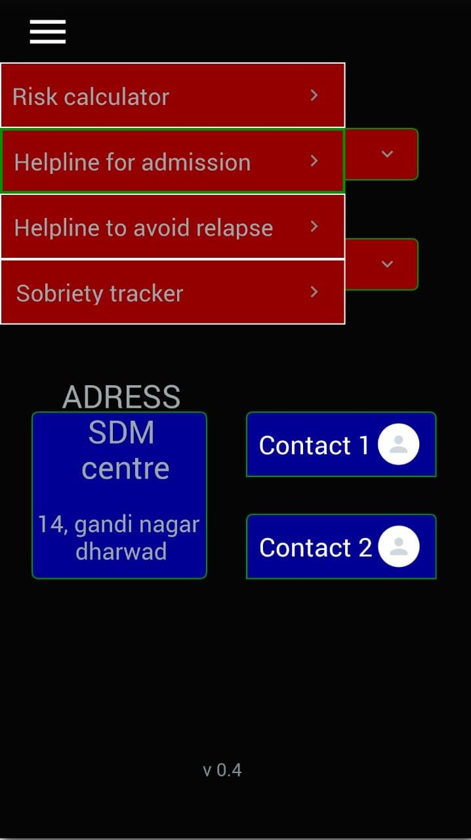
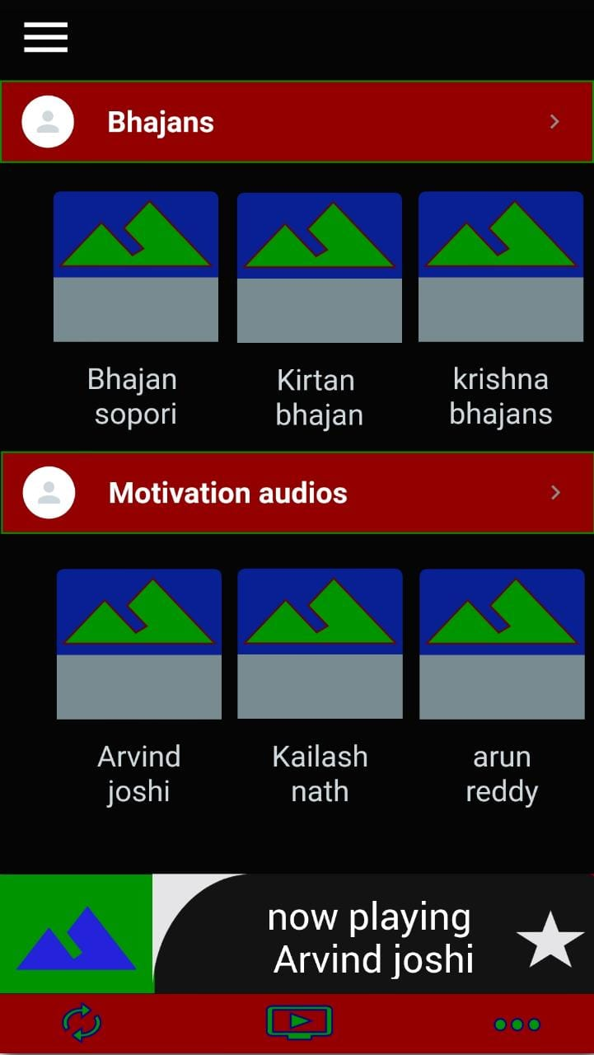

Slide 30
References
[1] https://www.statista.com/aboutus/our-research-commitment
[2] https://timesofindia.indiatimes.com/india/alcohol-kills-2-6l-indians-every-year-who-report/articleshow/65917785.cms
[3] https://www.therecoveryvillage.com/alcohol-abuse/alcohol-facts-statistics
[4]https://www.gatehousetreatment.com/internal-relapse-triggers-vs-external-relapse-triggers/
[5]https://powerofted.com/what-triggers-you-2/
[6] https://www.pwc.in/assets/pdfs/publications/2017/how-mhealth-can-revolutionise-the-indian-healthcare-industry.pdf

Slide 31
Thank you

